Slide 1
Radical Optimism

Slide 2
Radical Optimism
Radical Optimism:
  Life is basically good.
  Most key metrics have been getting better for the last few hundred years (at least).
  Most other problems are likely to be solved over time.
  Things can go bad, but the burden of proof is on the pessimist.
Website with all evidence: https://radicaloptimism.org/
2014 Presentation: https://averageradical.github.io/radicaloptimism/#/

Slide 3
What Radical Optimism Is Not
A lot of things suck.
Progress is bottlenecked on bad ideas.
Institutions are hard to change due to inertia.
Some things are unsolvable right now.
Entropy/Heat Death of the Universe?

Slide 4
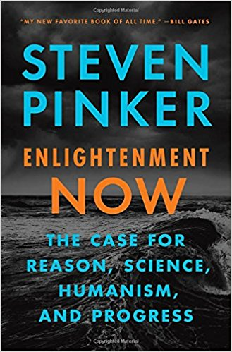
Optimism Has Gone Mainstream
Steven Pinker from Harvard publishes Enlightenment Now in 2018
  Bill Gates calls this his new favorite book of all time
For a video presentation with graphs, search YouTube for “Pinker Enlightenment Cato Institute”
Good book review and critique by Scott Aaronson: https://www.scottaaronson.com/blog/?p=3654

Slide 5
Agenda
Graphs of Key Positive Evidence
Discuss Best Objections
Practical Take-Aways

Slide 6
Three Key Graphs

Slide 7
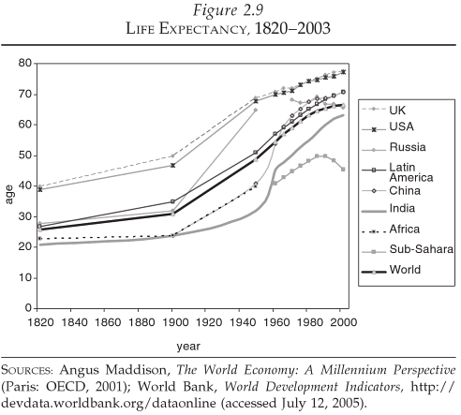
Global Life Expectancy
Notes:
Largely due to decreases in infant and maternal mortality, infectious diseases

Slide 8
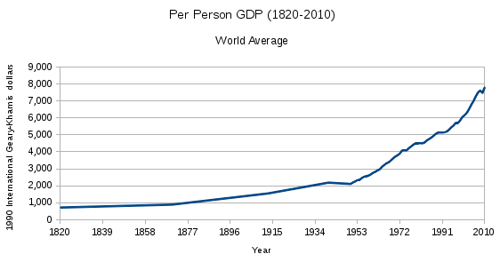
Global Per-Person GDP

Slide 9
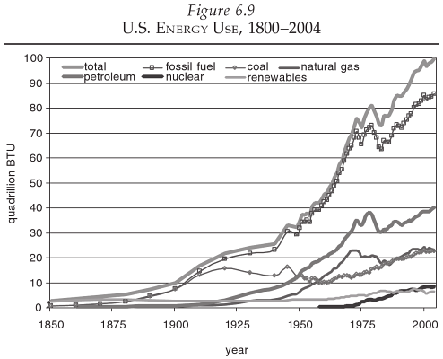
U.S. Energy Use

Slide 10
Other Good News

Slide 11
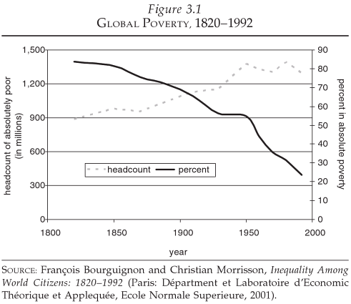
Global Poverty

Slide 12
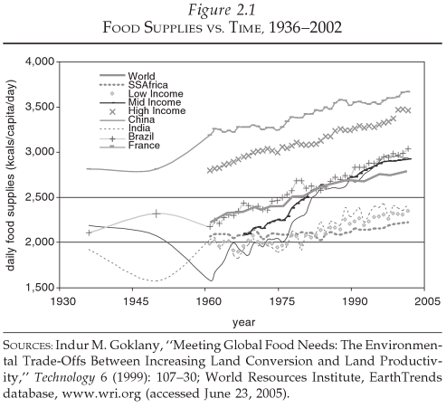
Global Calories Per Day Per Person

Slide 13
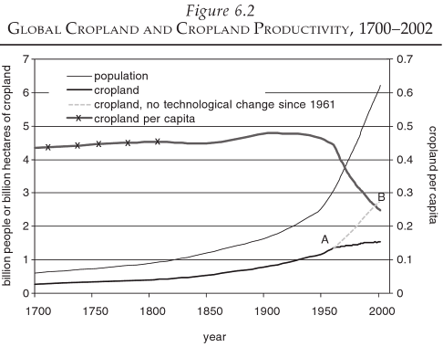
Global Cropland Per Person

Slide 14
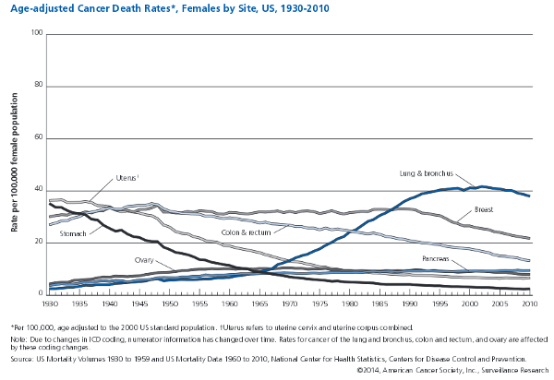
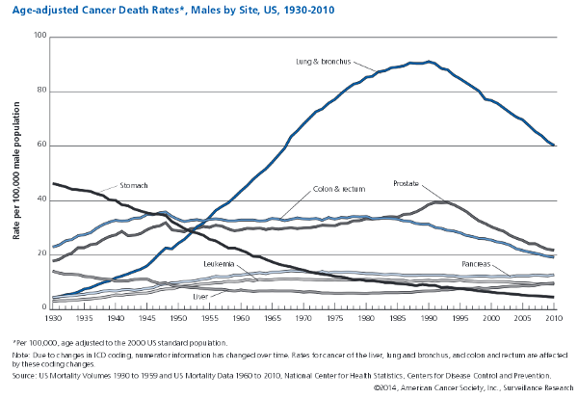
U.S. Cancer Age-Adjusted Mortality

Slide 15
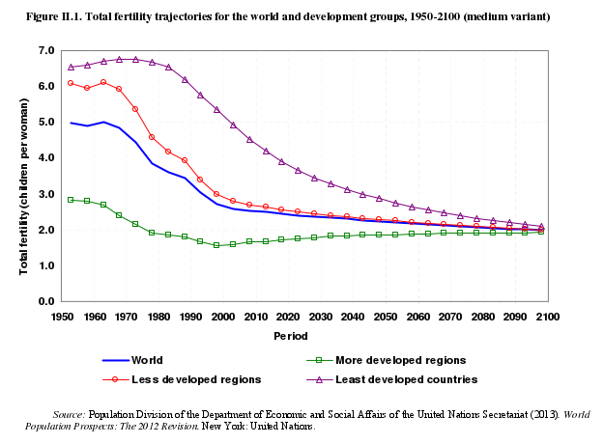
Global Fertility

Slide 16
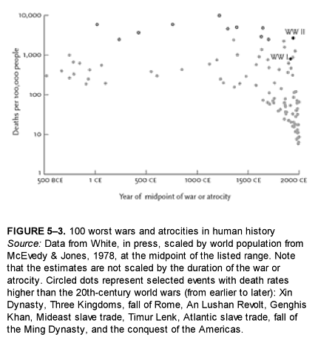
War Deaths Per Capita

Slide 17
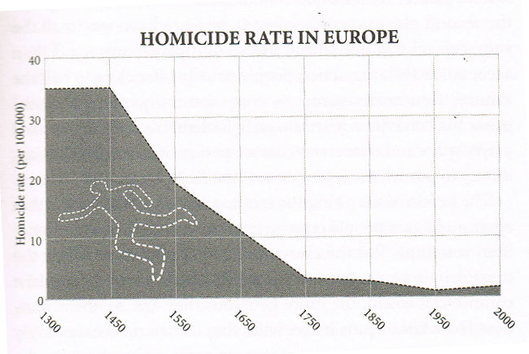
European Murder Rate

Slide 18
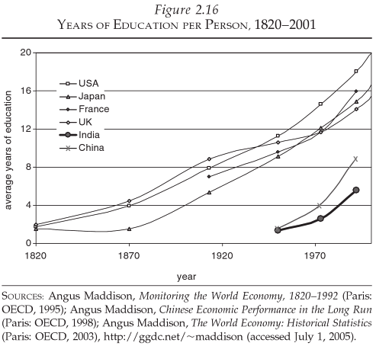
World Education Per Person
Flynn Effect: IQ rising at 3 points per decade

Slide 19
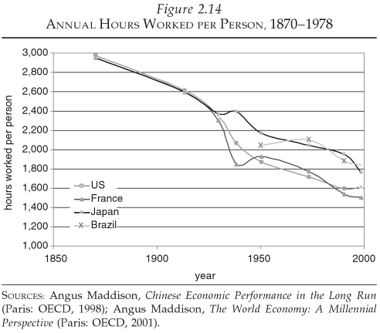
Work

Slide 20
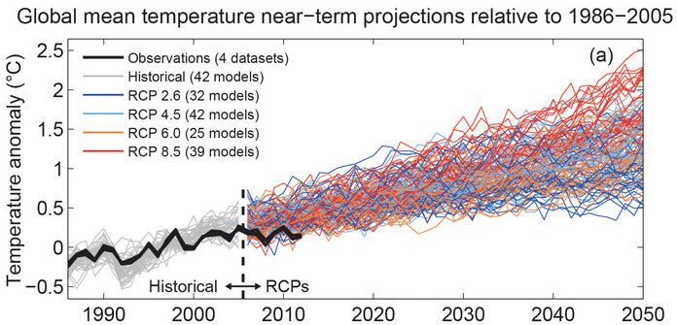
Climate Change

Slide 21
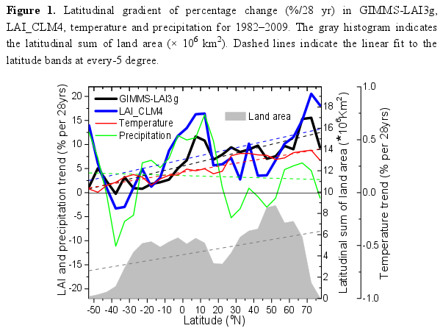
Climate Change

Slide 22
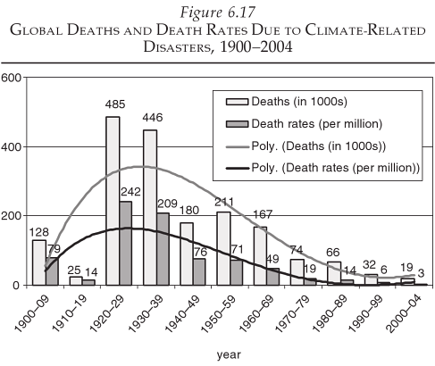
Climate Change

Slide 23
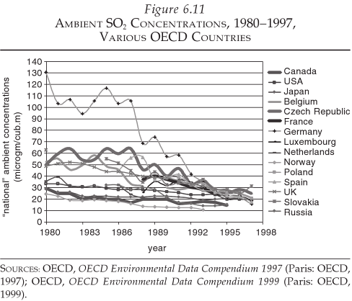
Pollution

Slide 24
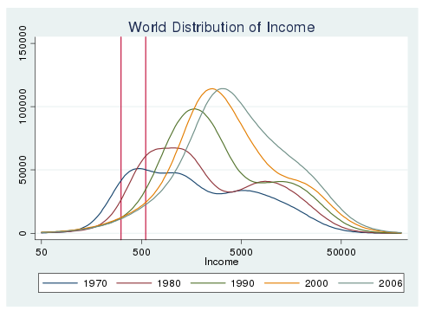
Inequality

Slide 25
Psychological Benefits of Optimism
Increased happiness, decreased depression (Seligman 2005).
Less likely to die of heart attack (Giltay 2004).
Tend towards better moods, more persevering and successful, better physical health (Peterson 2000).
Higher incomes (Diener 2002).
Better relationships (Gable 2004).
More creative thinking to solve problems (Isen 1987).

Slide 26
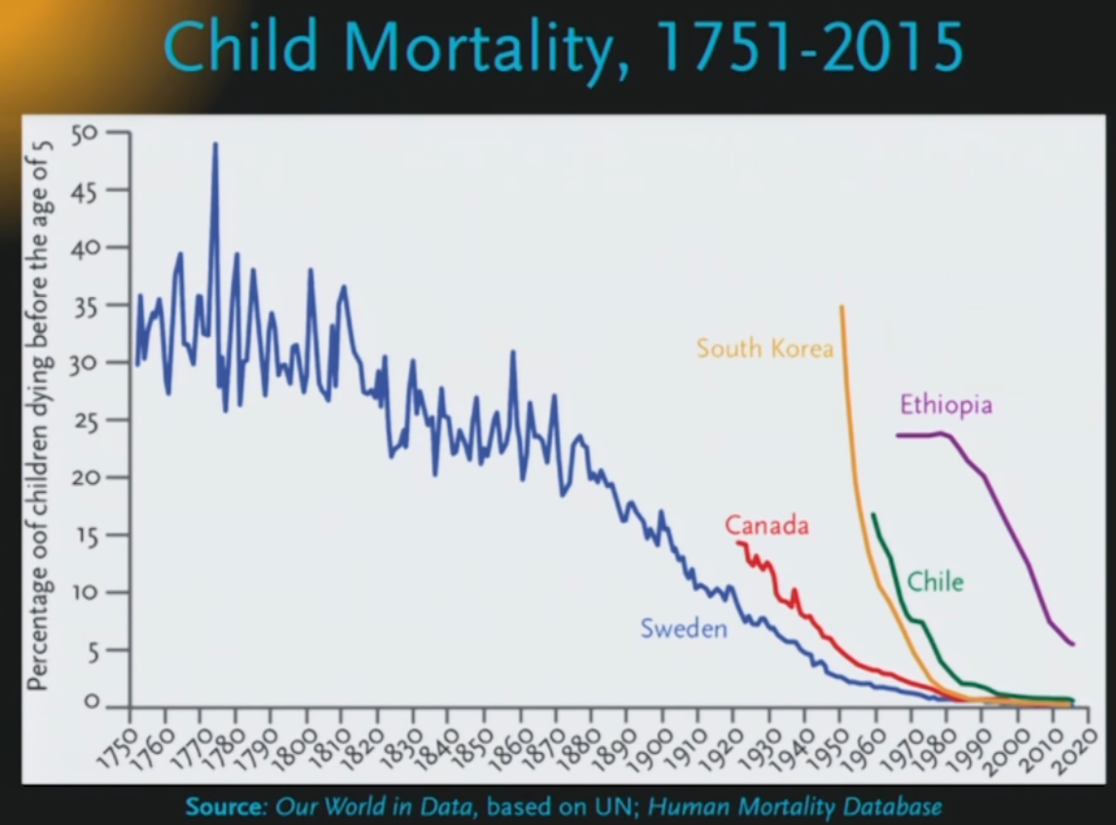
Child Mortality

Slide 27
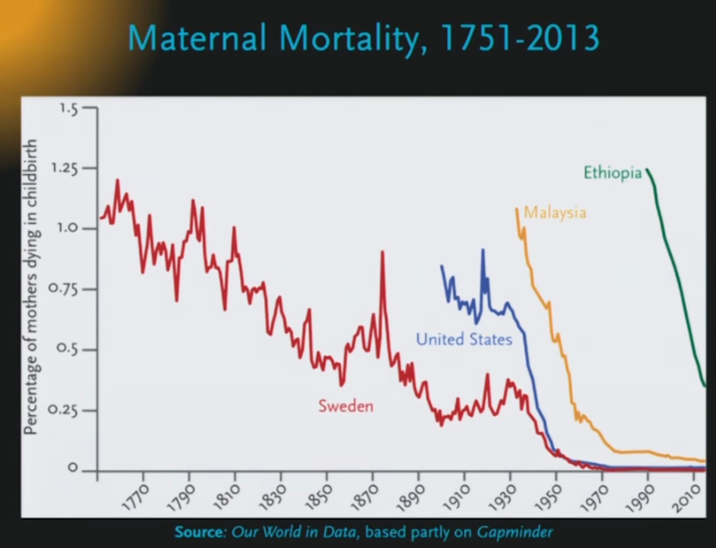
Maternal Mortality

Slide 28
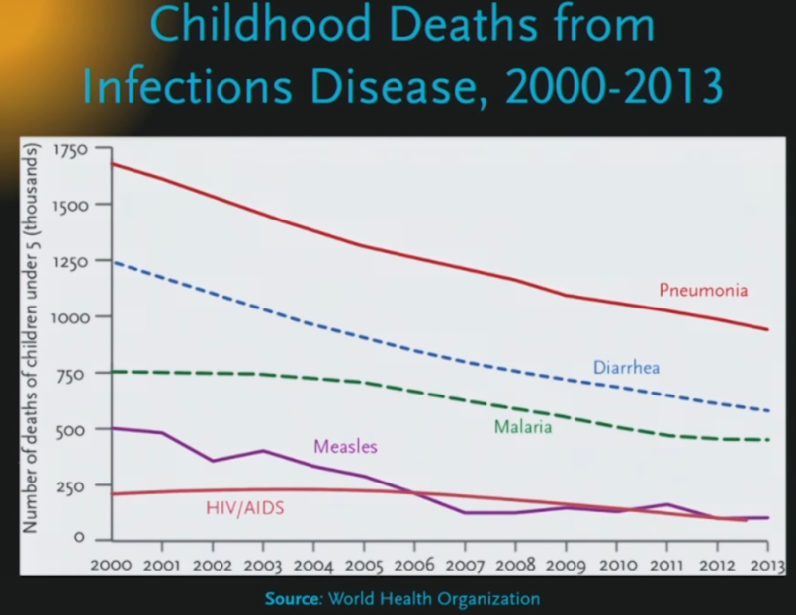
Infectious Diseases

Slide 29
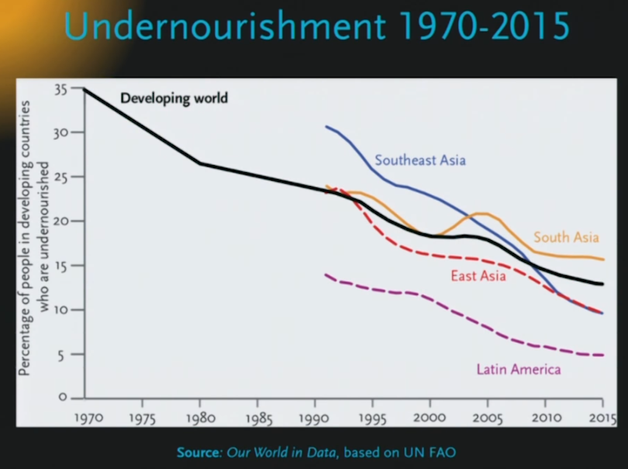
Undernourishment

Slide 30
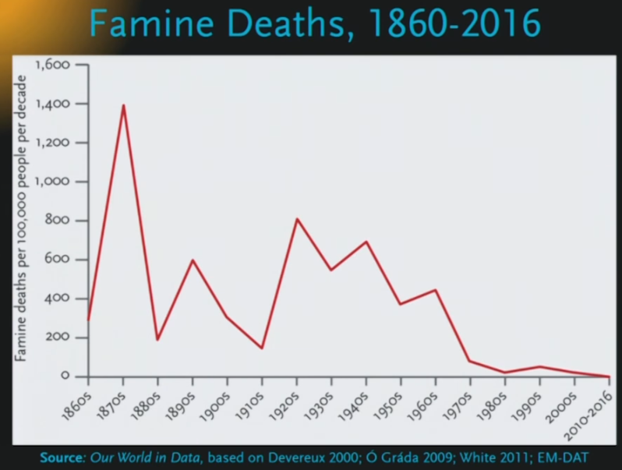
Famine Deaths

Slide 31
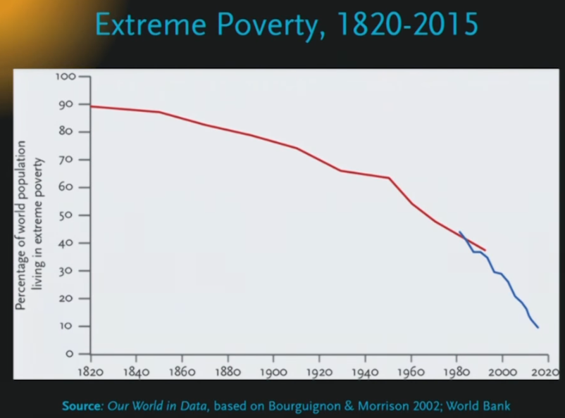
Extreme Poverty

Slide 32
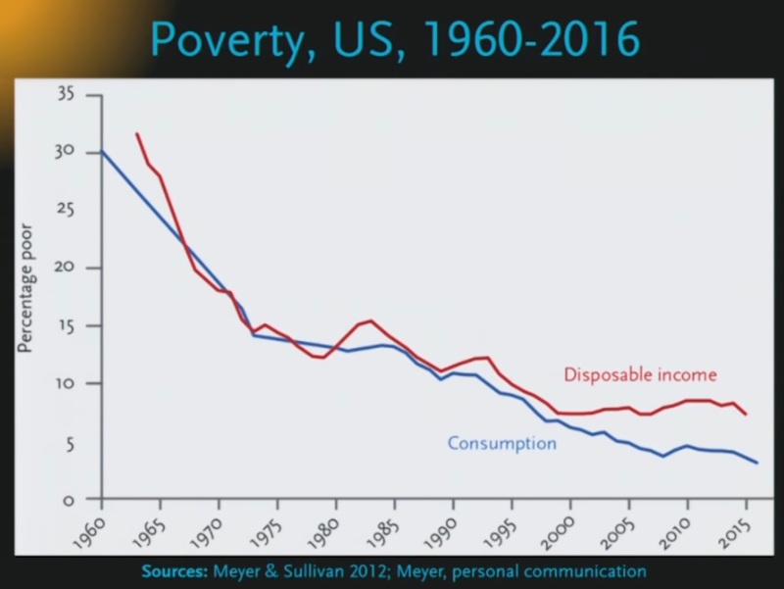
U.S. Poverty

Slide 33
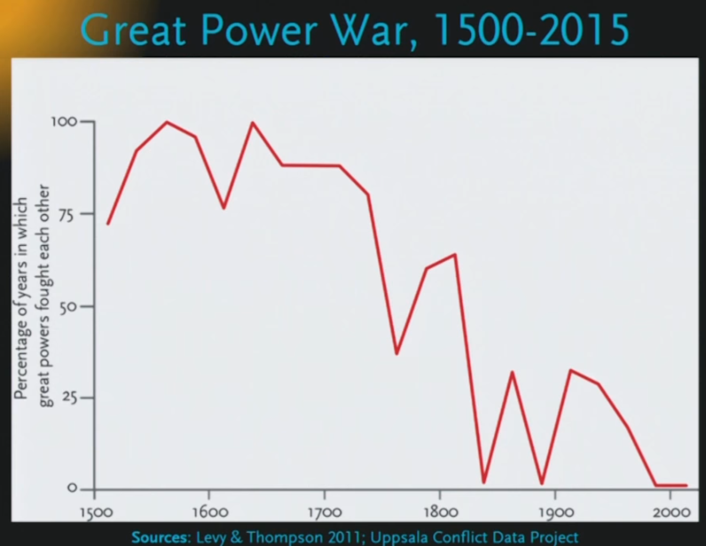
Great Power Wars

Slide 34
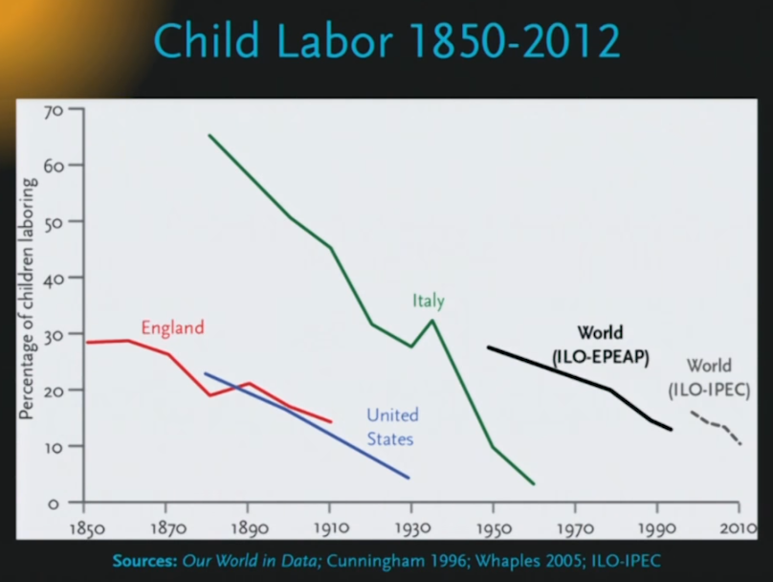
Child Labor

Slide 35
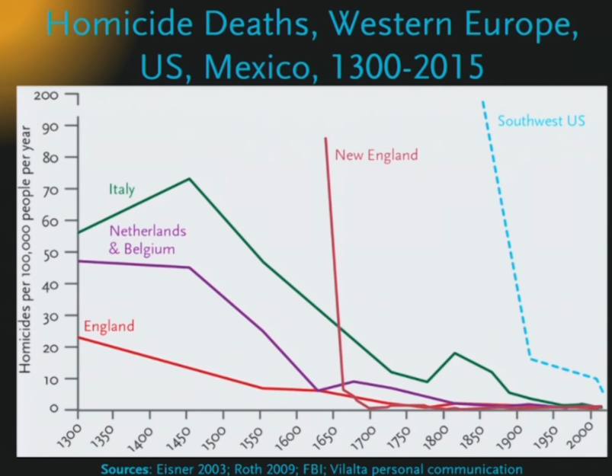
Homicide Rates

Slide 36
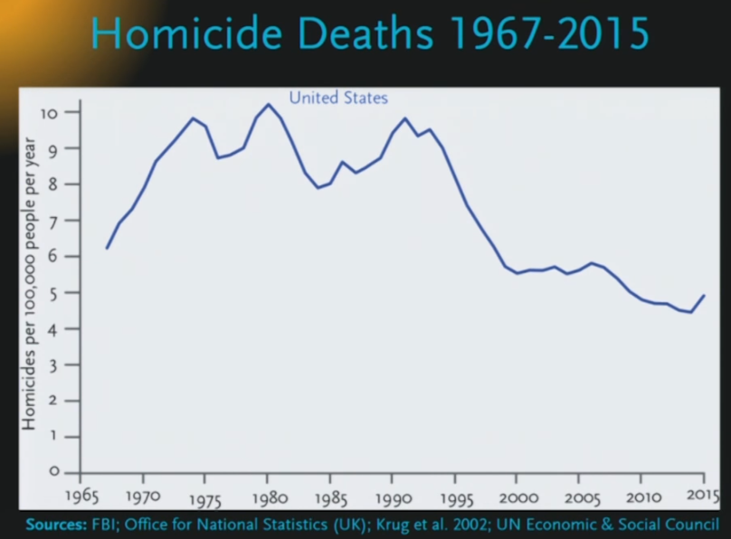
U.S. Homicide Deaths

Slide 37
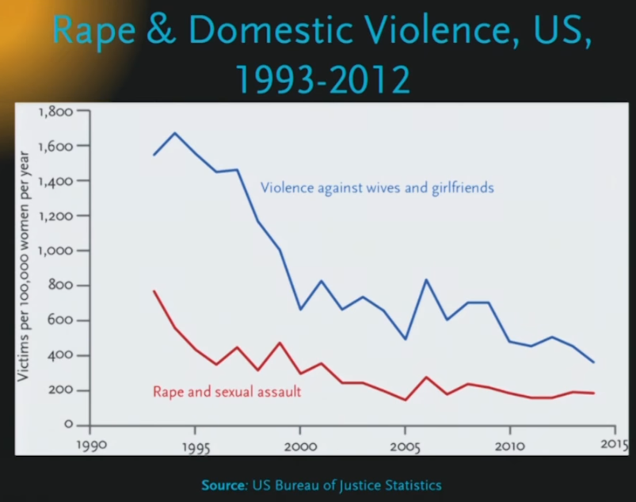
Rape

Slide 38
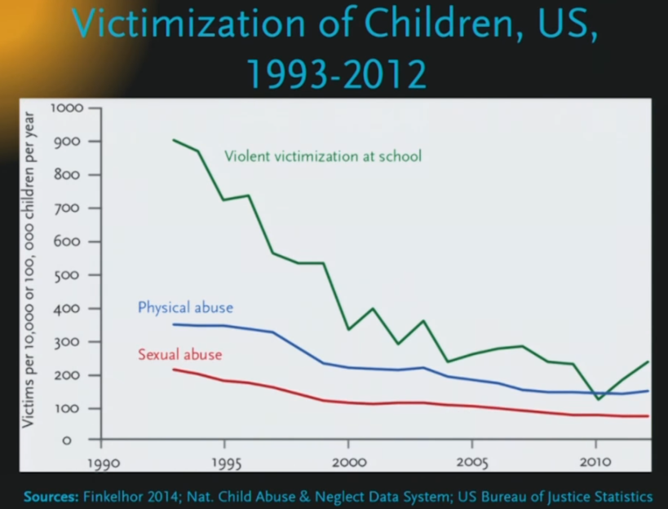
Victimization of Children

Slide 39
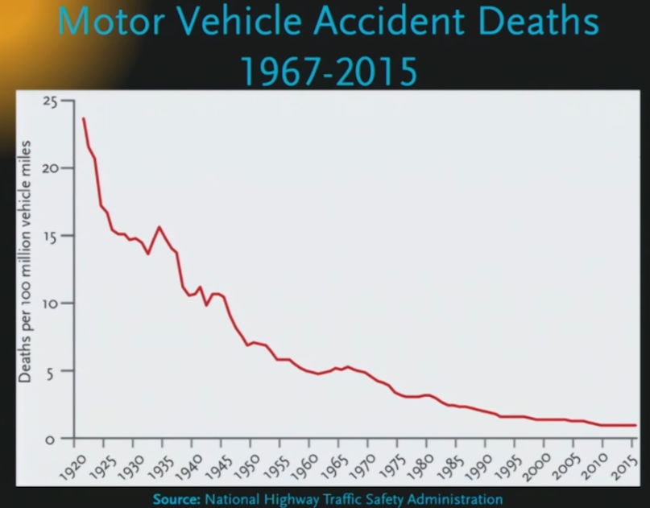
Motor Vehicle Deaths

Slide 40
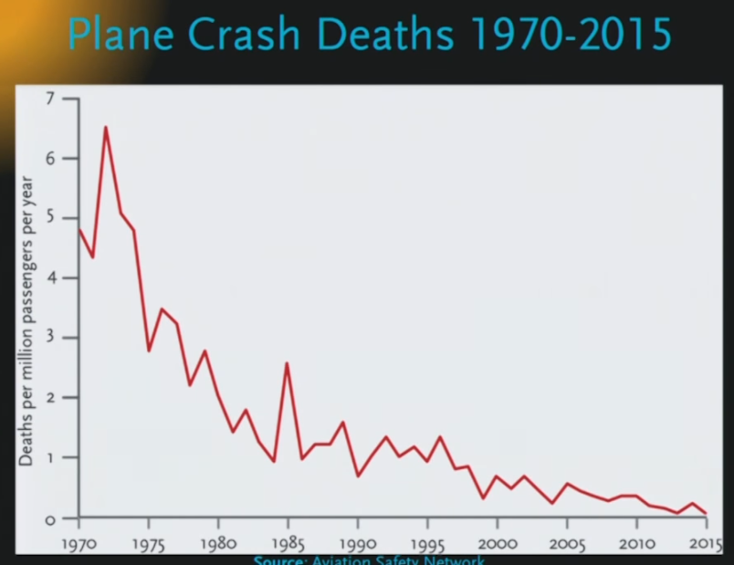
Plane Crash Deaths

Slide 41
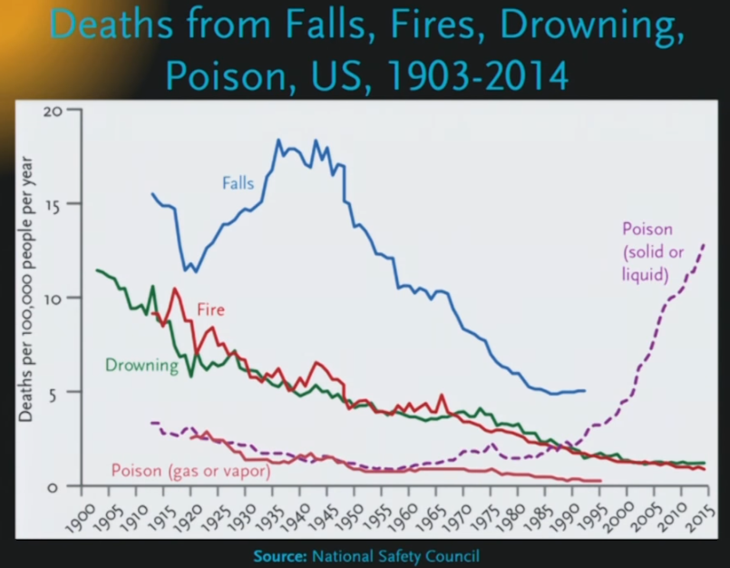
Falls, Fires, Drowning, Poison

Slide 42
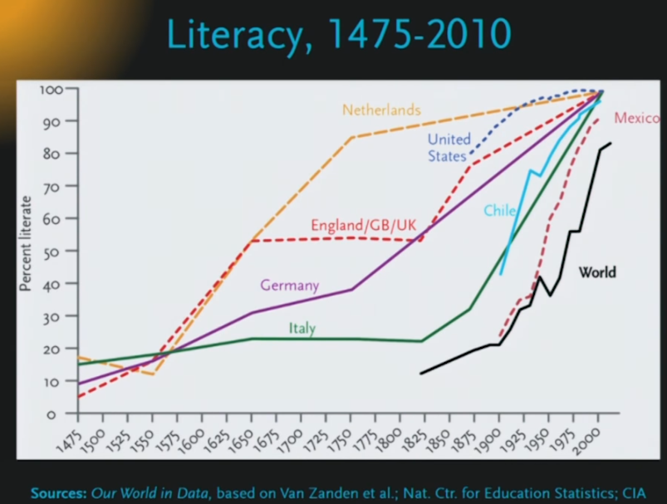
Literacy

Slide 43
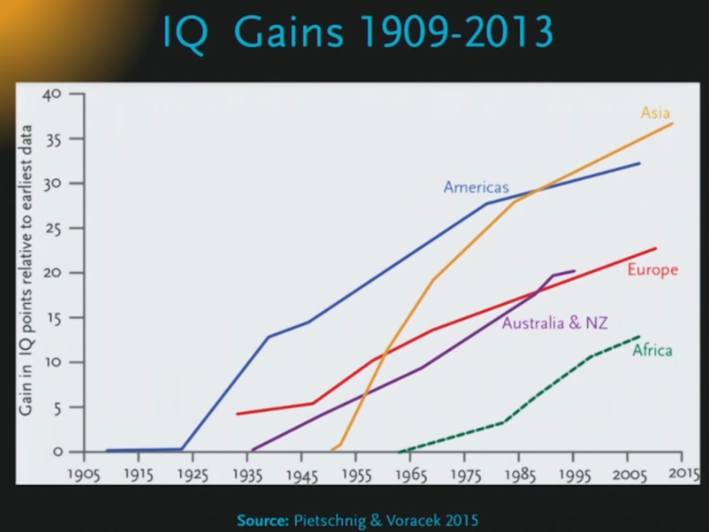
IQ Gains

Slide 44
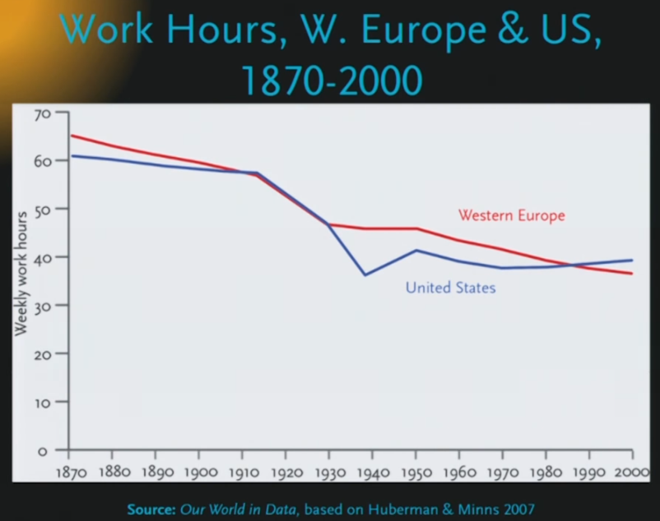
Work Hours

Slide 45
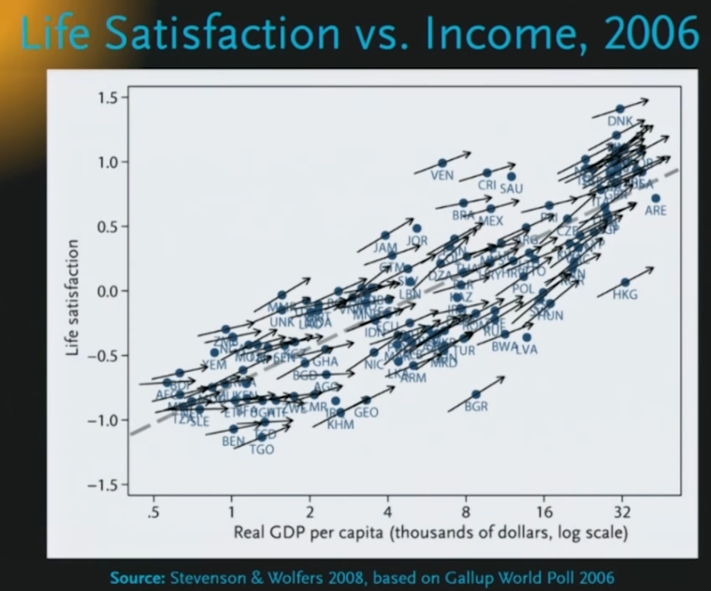
Life Satisfaction vs Income

Slide 46
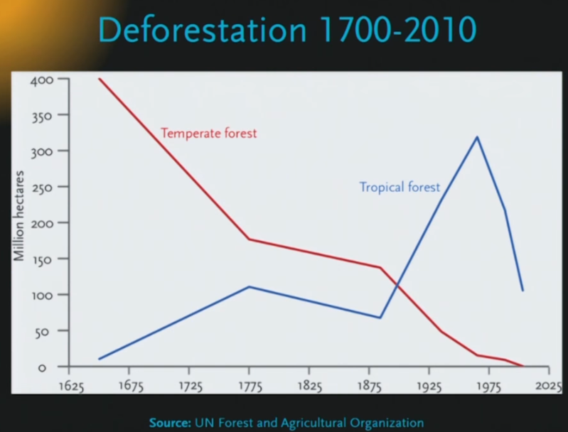
Deforestation

Slide 47
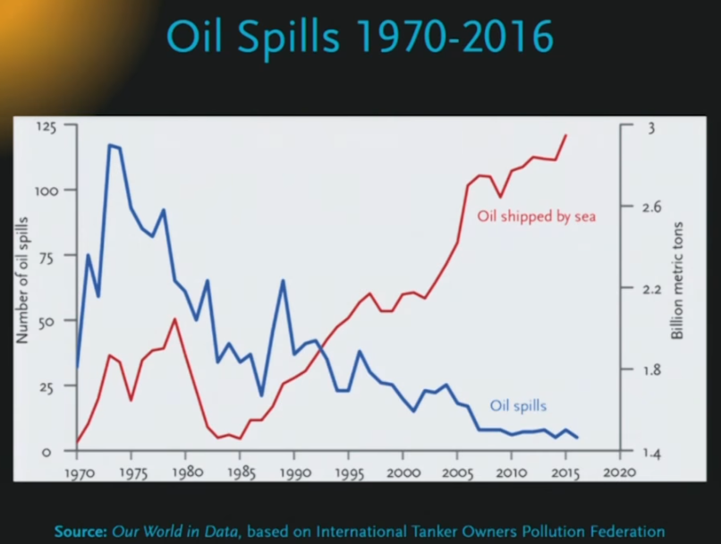
Oil Spills

Slide 48
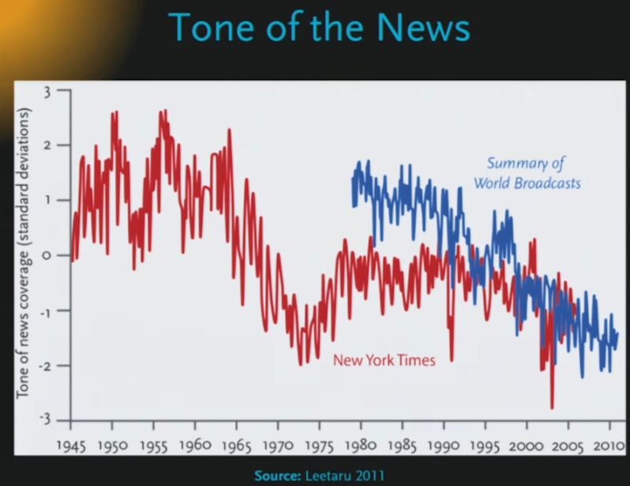
Tone of News Coverage

Slide 49
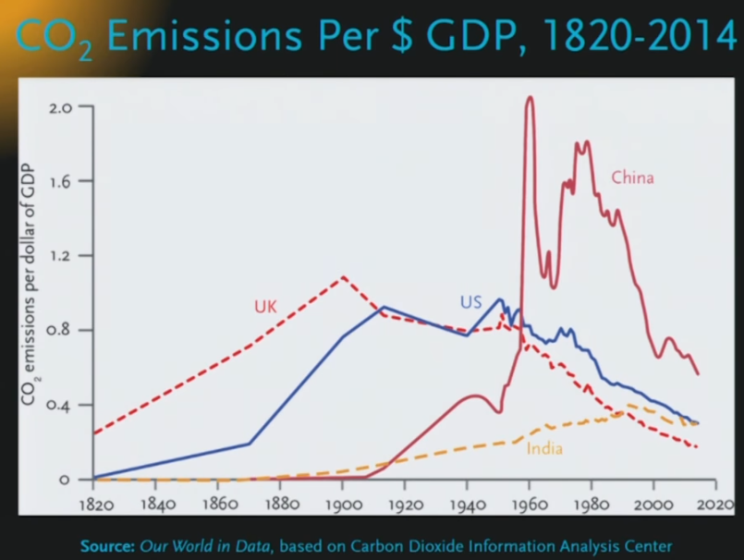
CO2 Emissions per GDP

Slide 50
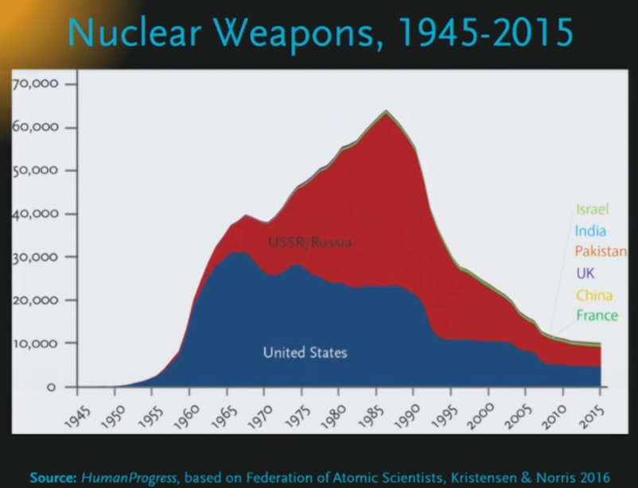
Nuclear Weapons

Slide 51
“Realism”
"Realism" is often status quo biases and emotional prejudices wrapped in a pretense of objectivity and balance.
Actually cynical because it disregards optimistic evidence.
One way to tell a "realist" versus a realist: Are they curious about the evidence of optimism?
True realism usually warrants, at minimum, some optimism.

Slide 52
Call to Inaction?
No! Let's work to improve the world more.
Economic progress seems to be the main driving force.
Morality seems to be progressing (may be correlated with wealth).
As Ridley writes, progress has occurred despite the "chiefs, priests, and thieves."

Slide 53
Quote
“Despite "recklessly" increasing its numbers... humanity has never been better fed, healthier, or longer lived... the average person's life span has more than doubled. He is better educated and wealthier. She is freer to choose her rulers and express her views... Her professional, social, and physical mobility... is less likely to be circumscribed by caste, class, location, or other accidents of birth. Not only is work less physically demanding, he works fewer hours, earns more, and has more leisure time at his disposal. The proximate causes for the improvements in the human condition... are the forces of technological change and economic growth, supplemented by trade in products, ideas, and technologies.” (Goklany)

Slide 54
Bryan Caplan’s Beautiful Bubble
“Why put so much distance between myself and the outside world? Because despite my legendary optimism, I find my society unacceptable. It is dreary, insipid, ugly, boring, wrong, and wicked. Trying to reform it is largely futile; as the Smiths tell us, "The world won't listen." Instead, I pursue the strategy that actually works: Making my small corner of the world beautiful in my eyes.”

Slide 55
Bryan Caplan’s 10 Steps to a Beautiful Bubble
Amicably divorce your society. We’re not right for each other.
Unless you can do something about a problem, don’t worry too much about it.
Read history books instead of news.
Emotionally distance yourself from toxic people.
Stop worrying about first world problems
Fill life with joy
Make friends who share your likes instead of your dislikes
Search for a meaningful life (including work)
Date people who share your values
Now that your life is in order, explore the dumb world around and go home to your beautiful bubble

Slide 56
Best Objections
Nuclear War
  Number of warheads on a good downward trend but of course it doesn’t take many to cause a disaster
  We got through the cold war (with some close calls!), so at least some evidence that humans can handle it. Even tyrants are somewhat rational.
Unexpected Disaster
  The more average wealth & energy, the better our chances
  Burden of Proof on the Pessimist.
Global Government
  My biggest fear. Without competition between governments, it can get scary
  Seastedding, going to other planets.

Slide 57
Best Objections
Superintelligent Artificial Intelligence
  Pinker is skeptical, thinks AI will just augment, General AI may be incoherent
  Burden of Proof on the Pessimist.
World War III
  Always possible but even WWII wasn’t much of a blip in the trends
Terrorism
  It’s terrible but a blip in the big scheme of things
  Burden of Proof on the Pessimist.
GMO, CRISPR-Cas9, and other Scary Biological Advances
  For hundreds of years, we’ve been doing GMO through radiation, now we are surgical

Slide 58
Best Objections
Authoritarianism
  Certainly possible and our political system tends to encourage emotional appeals
  Nevertheless, it has been on the decline. Burden of Proof on the Pessimist.
Climate Change
  Burden of Proof on the Pessimist.
How can a human race that reacts in the ways it does to modernity be trusted to use those gifts responsibly?
Even a slight loss of modernity will cause great havoc

Slide 59

You’ll Do Great Today

